Slide 1
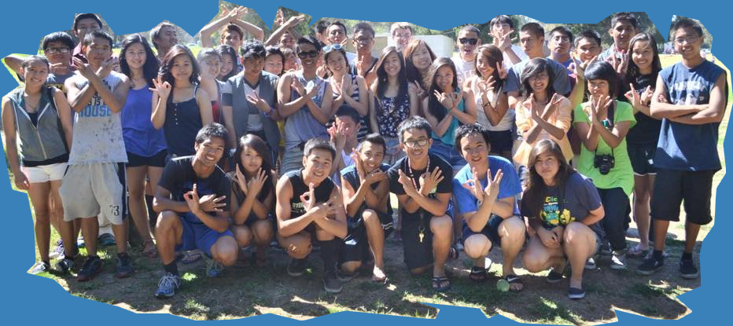
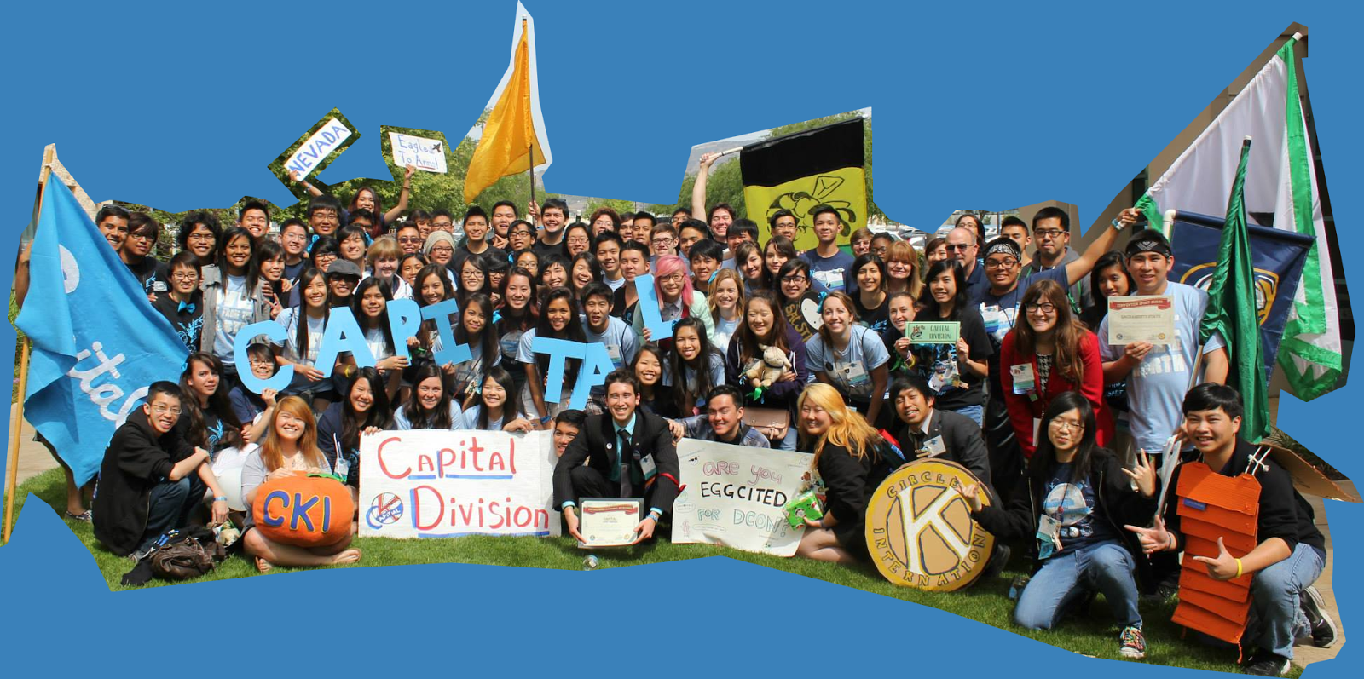
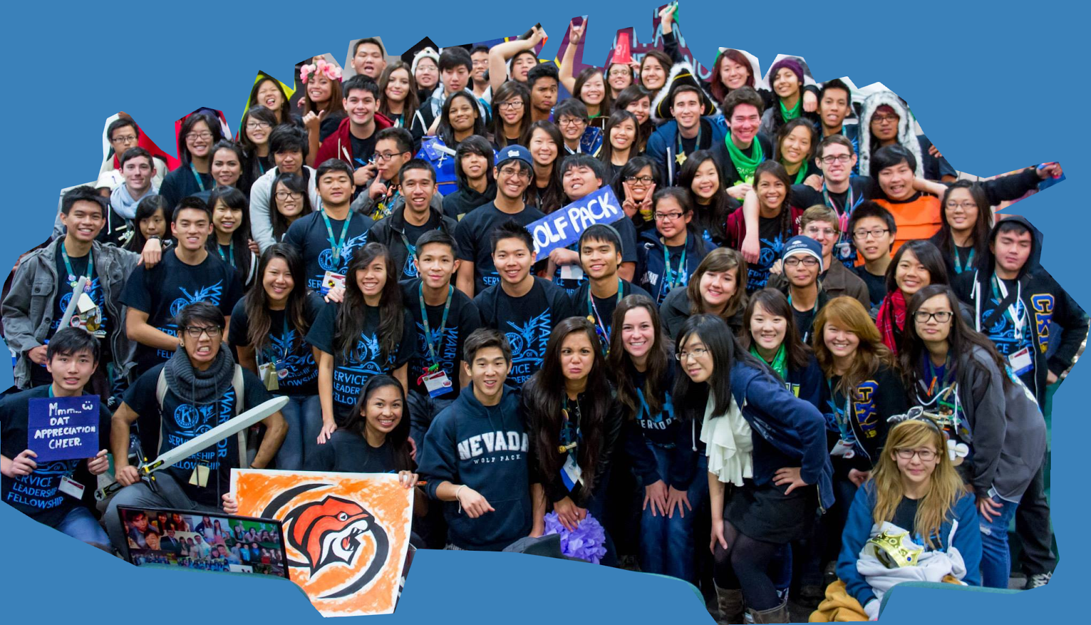
From Key Club to Circle K
Hosted by Arianna Dela Rosa and Vanessa Yeh

Slide 2
Arianna
Key Club Member 2009-2011
Key Club Bulletin Editor 2012-2013
Circle K Member 2013-2014
Circle K Newsletter Chair 2014-2015

Slide 3
Vanessa
Key Club Event Coordinator 2009-2010
Key Club Secretary 2010-2011
Key Club President 2011-2012
Key Club D12E Lt. Governor 2012-2013
Circle K Fundraising Chair 2013-2014

Slide 4
High School College
More restrictions
Limited to same class mates and environments
Schedule is chosen for you
Parental consent
Key Club
More opportunities to network
Exposure to different types of environments and people
Freedom to choose your own schedule
No parental consent
Circle K

Slide 5
Key Club vs. Circle K
limited to what events you can do
“what to go to a good college” mindset”
larger community
need to consider consent of adult figure
more opportunities to do a different array of service, social, and leadership events (connect personal or academic interests to events)
more legitimate mindset
tight-knit smaller community
open-minded

Slide 6
Arianna’s Experience

Slide 7
Vanessa’s Experience

Slide 8
Q & A
Have questions?
We have answers!
Vanessa Yeh: vjyeh@ucdavis.edu
Arianna Dela Rosa: aridelarosa.cki@gmail.com

