Slide 1
The College Experience
Presented by Jacky Liu and Chusila Lee

Slide 2
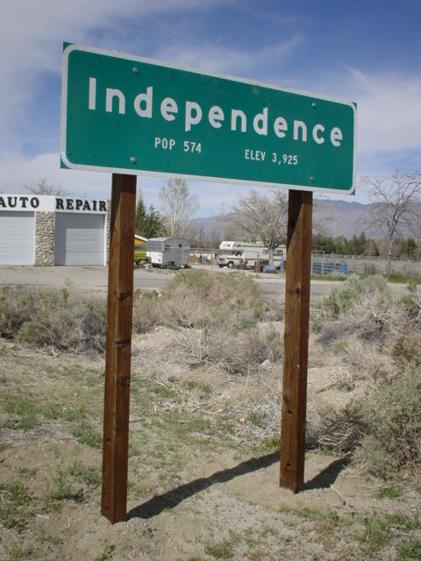
What’s Unique About College?
-For most people, College is the first time that a person is independent from their parents.
-College is an opportunity for people to discover more about themselves.

Slide 3


Moving to a New Place for College
Oxford University
University of Florida

Slide 4
What to expect from College
-”College is a completely different ball game than high school.”-Jacky Liu(2nd Year)
-”Expect the Unexpected.”-Melanie Wong (3rd Year)
-”College is a Buffet, Always go for Seconds.”-Brandon Chen(2nd Year)
-”Don’t underestimate your first exam.”-Anonymous (4th Year)
-”Don’t Take it Lightly.”-Anne (3rd Year)
-”How you use your time will define you.”-Andrew Tom(4th Year)
“You Do You.”-Ryan Tom ( 3rd Year)

Slide 5
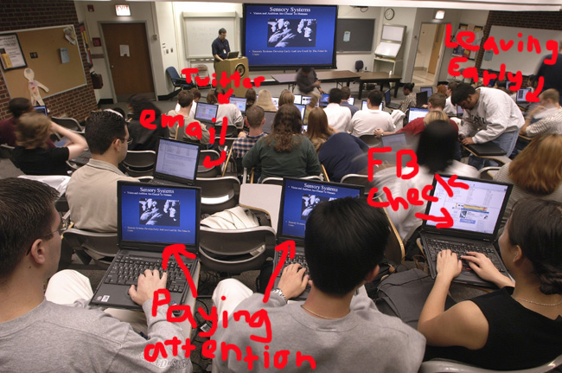
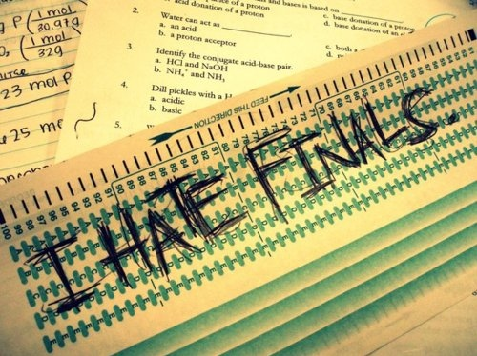
Academics aka Why You Go To College

Slide 6

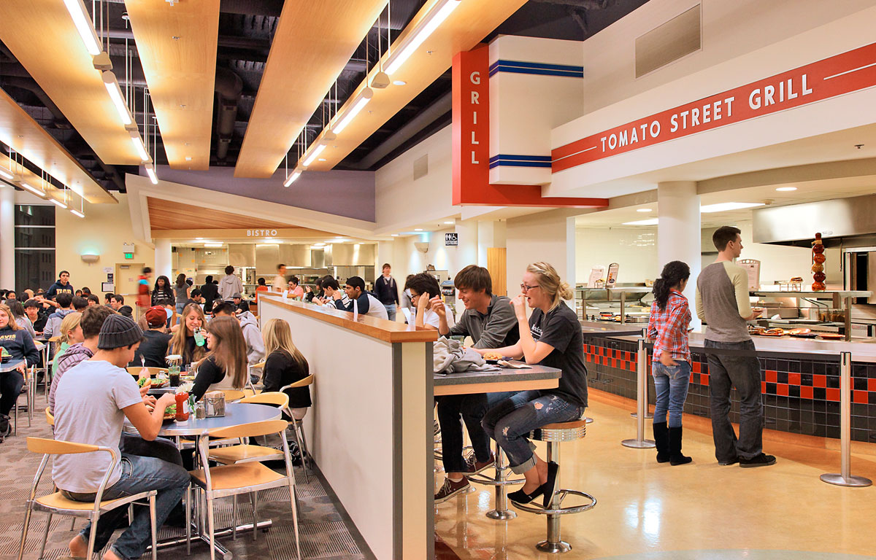
Typical First Year College Experiences

Slide 7
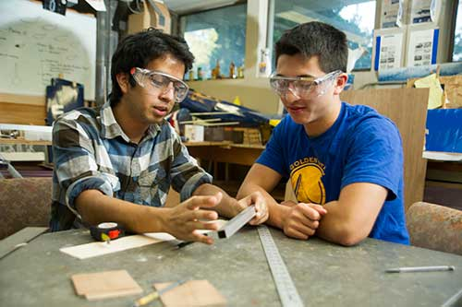
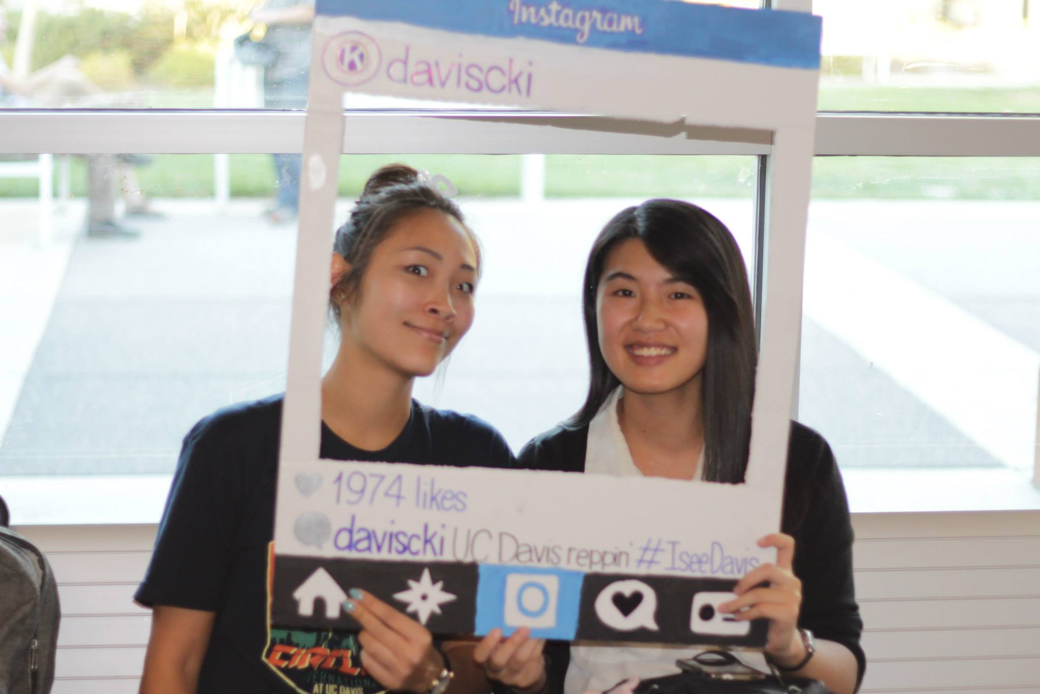
Meeting New Friends!

Slide 8
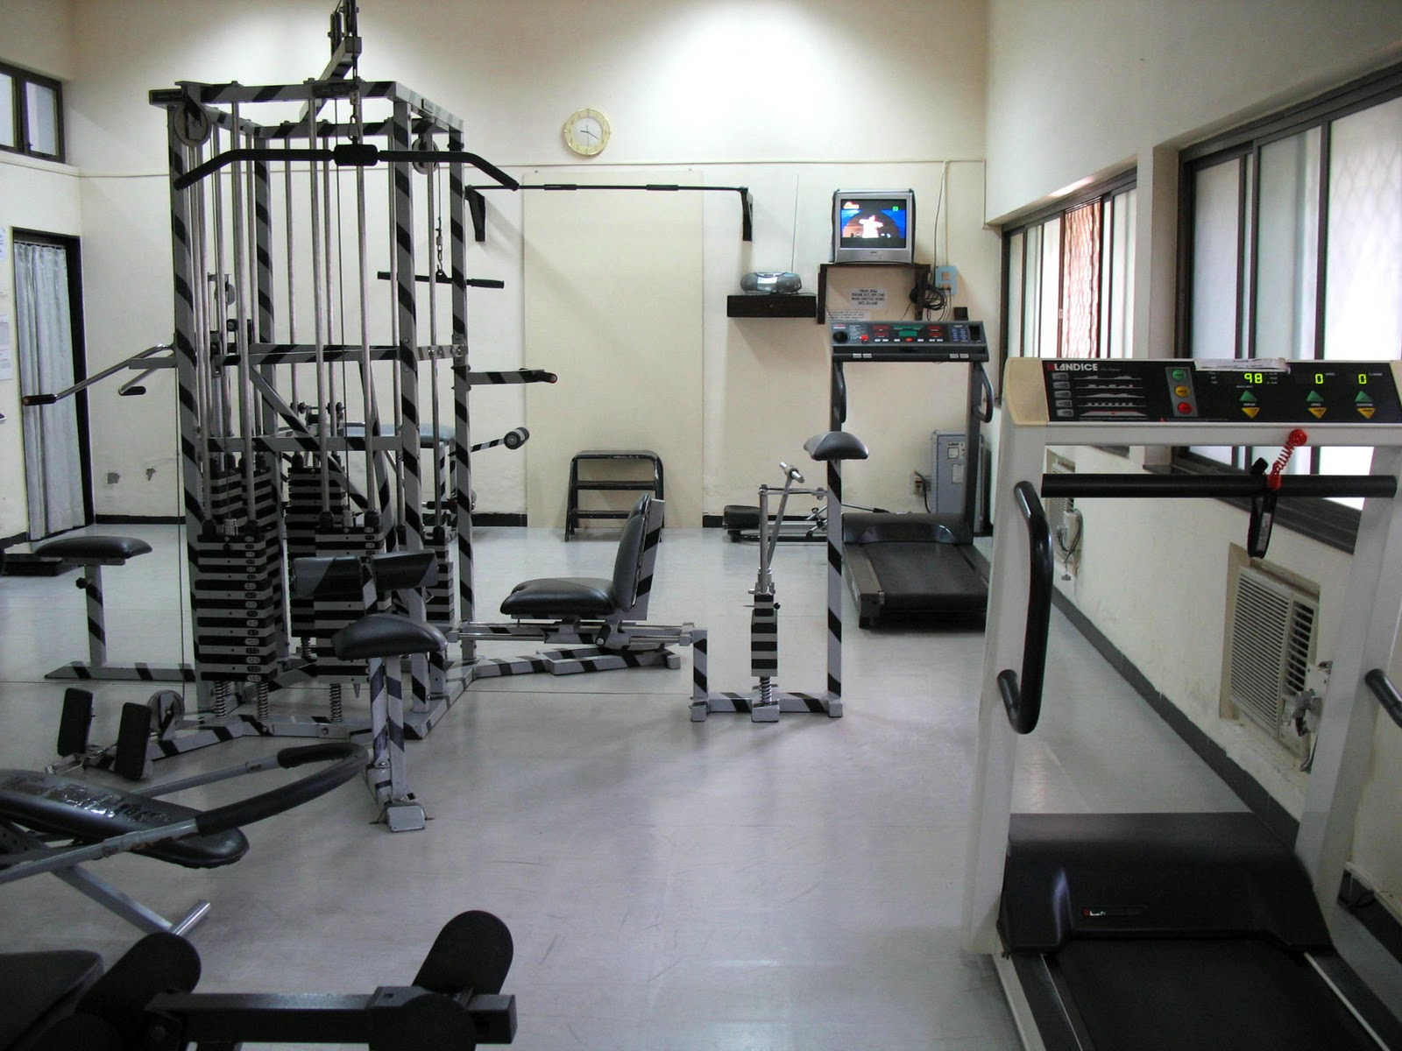

Extracurriculars

Slide 9
Common College Myths
-The Freshman 15
-I Need To Decide a Major, before I enter College
-Your College Experience will be like everyone’s elses
-Your life will be ruined if you are rejected from your first choice.

