Slide 1
Application PROCESS
Presented by:
Tyler Bowman
Emily Kotcher

Slide 2
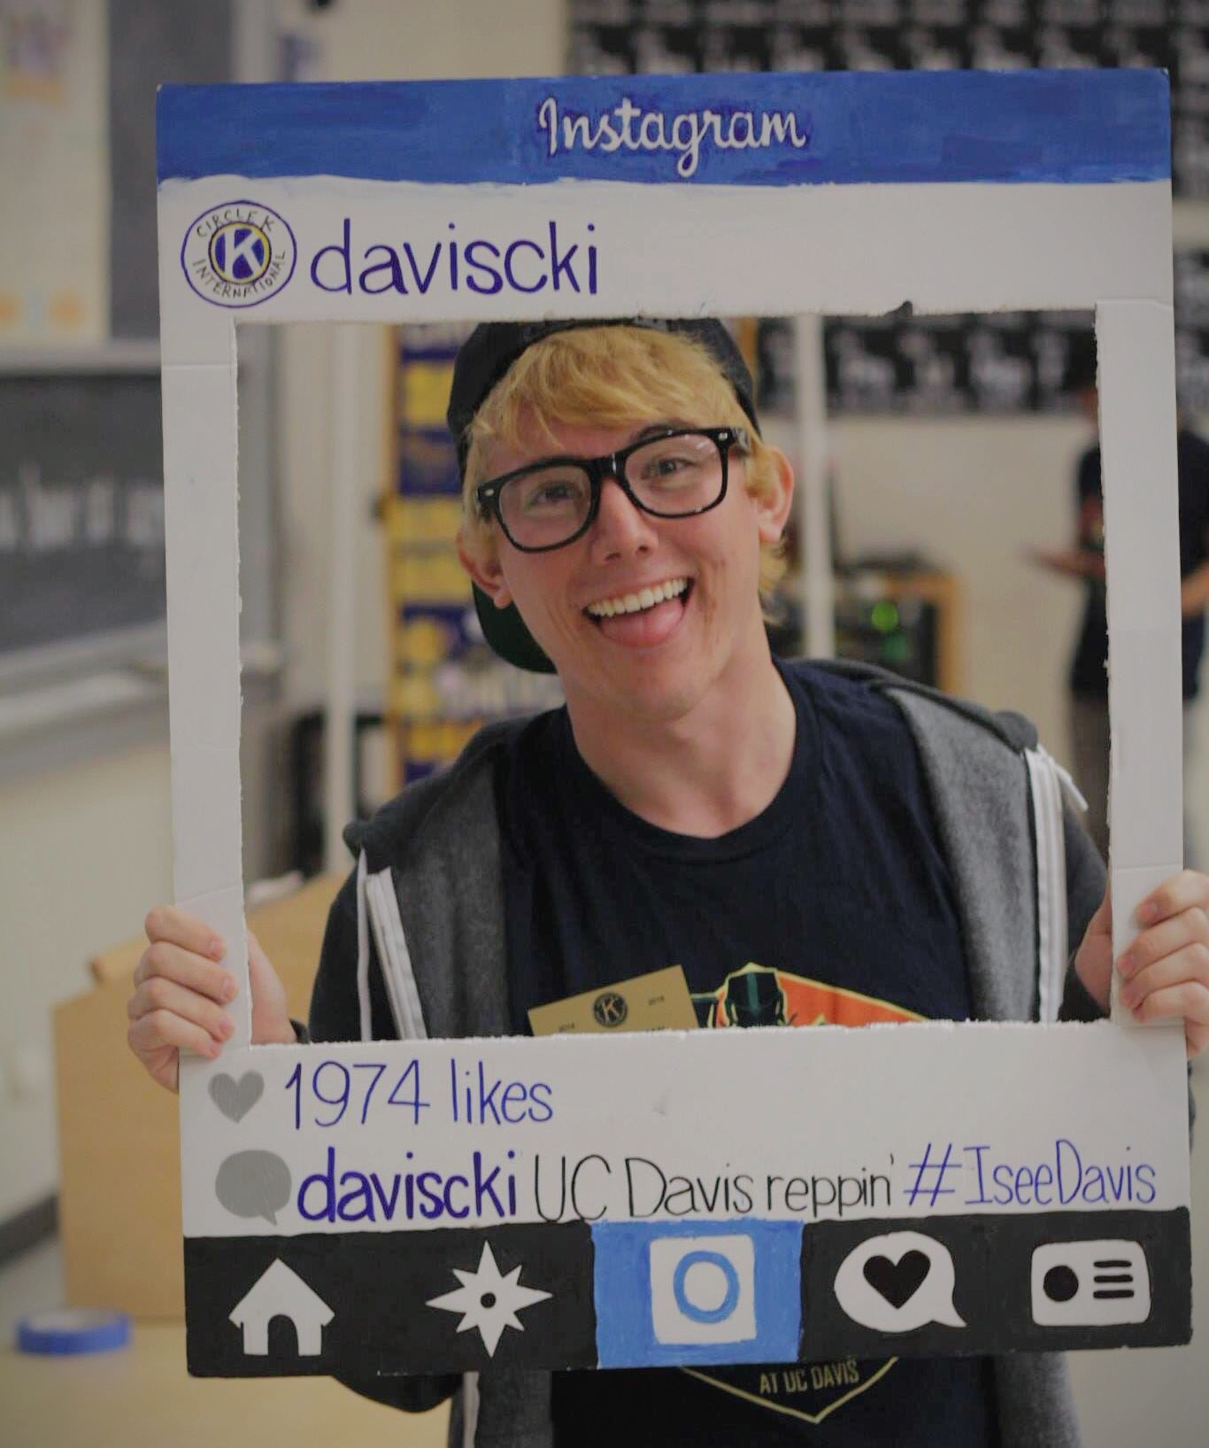
Tyler bowman
2nd year Wildlife, Fish, and Conservation Biology major
UC Davis Kiwanis Family Relations Chair
Likes K-pop, Indie, Pop, and EDM
Has chronic hiccups
Kinda looks like Tyler Oakley

Slide 3
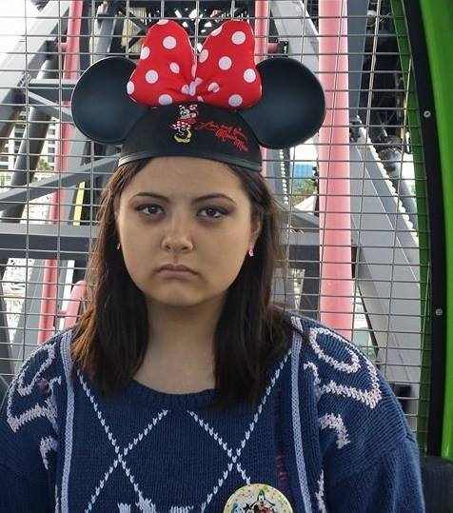
Emily kotcher
2nd year Animal Science major
UC Davis Circle K Member of the Season - Summer 2014
Has 3 fabulously sarcastic sisters
Used to be a 44S Dino
Obsessed with Avatar: TLA, and Legend of Korra

Slide 4
icebreaker

Slide 5
What we will cover
How to apply to community colleges
How to apply to CSU’s
How to apply to UC’s
How to apply to Private Universities
Timeline of events you should keep in mind when applying.

Slide 6
before you apply you should have
A copy of your transcript
Test scores (SAT, SATII, ACT, AP, IB, etc.)
Personal Information
SSN, address, parent information
Essays should be prepared beforehand.
Look at essay prompts early and work on them until they’re as best as you can do.
Look into majors at every campus you’re applying to and the classes you need for those majors so you have an idea of what you want to do.
You can always apply as undeclared

Slide 7
How to apply to CC’s
Talk to your high school counselors
Go on that CC’s website and follow the steps to apply. That’s it!
No test scores (SAT/ACT) needed!
You’re guaranteed admission. They can’t reject anyone.
There is nothing wrong with going to a CC and then transferring! It’s actually recommended.

Slide 8
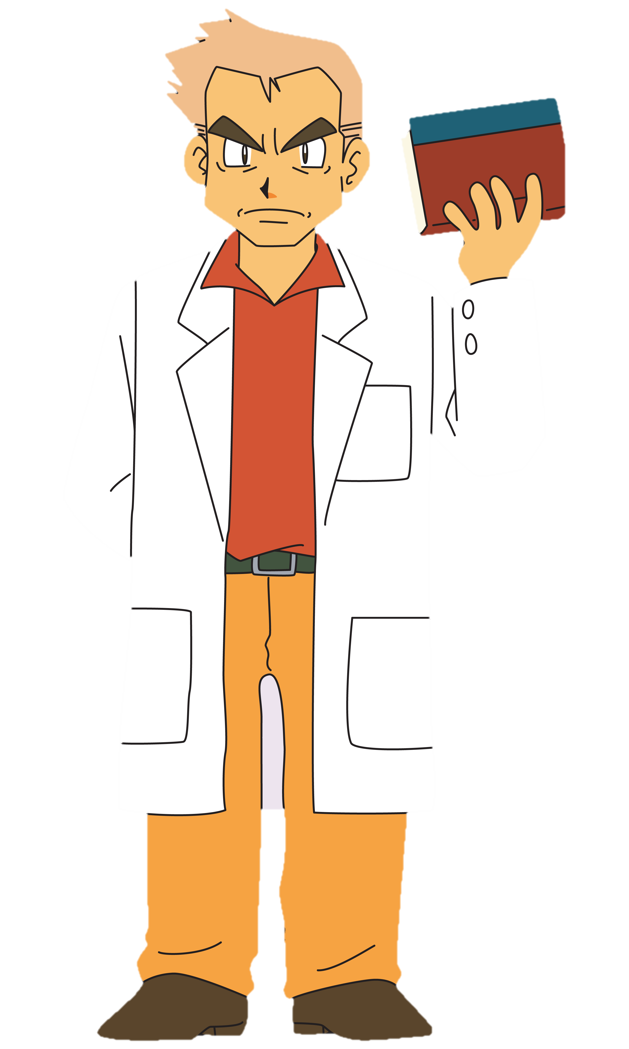
How to apply to csu’s
Application can be found at <csumentor.edu>
Apply now!!!!
Make sure you have taken all the prerequisite courses needed to apply (A-G req)
Take SAT/ACT in advance so that you have time to retake it
Make sure you fit the SAT/GPA index
Make sure you apply ASAP.
Some admit early
No essay needed!
Just enter your information accurately and that’s all!
Focused on preparing you for a job after you graduate

Slide 9
How to apply to uc’s
Application can be found at <admissions.universityofcalifornia.edu>
Apply now!!!!
Application is similar to CSU application except it’s one application for all UC’s
Make sure you have taken all of the A-G requirement classes
Must have GPA of 3.0+
Cannot have any grade lower than a C.
2 essays required. Work on these early.
Focused on getting you research opportunities to help you pursue higher education

Slide 10
How to apply to private universities
Some have their own application
Most use the Common App <commonapp.org>
This is long. Very long. Be prepared.
Common App is essentially all writing.
It has 2 mandatory essay prompts
Each school on the Common App has its own supplemental “essay” questions.
This is in addition to the essay questions already on the Common App
These can add up really quickly and you can quickly find yourself filling out 10+ short essays if you apply to a lot of schools.
Prompts can be really random. Some may only require a sentence. College admissions are weird.

Slide 11
Timeline of events
<http://abt.cm/1heBUMs>
Consider applying early action.
QuestBridge is a good program to apply for.
Partnered with Ivy Leagues and other top ranking privates (Stanford, etc.)

Slide 12
Questions? :)

